Slide 1
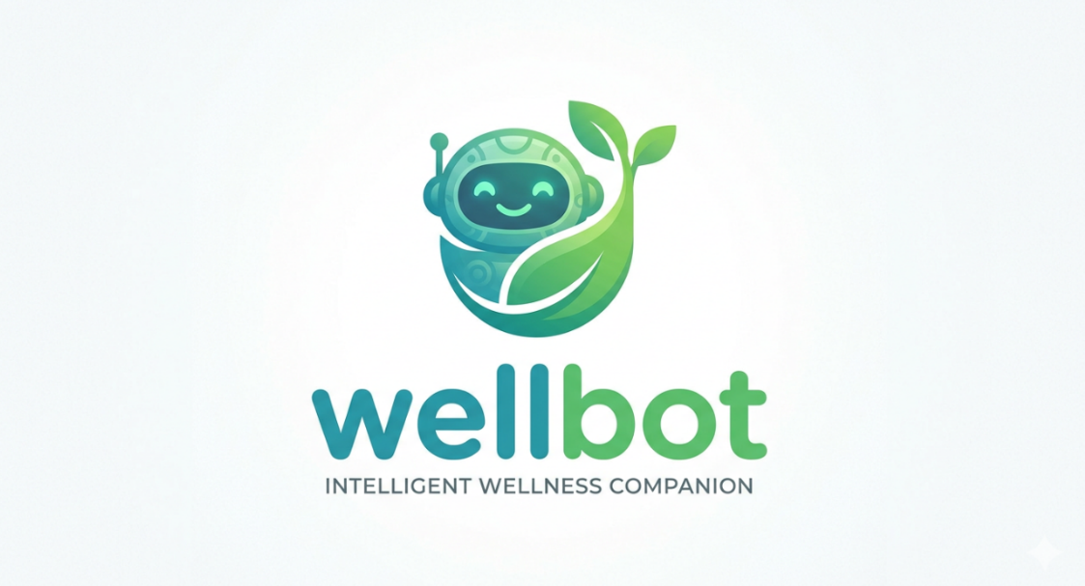
🌿 WellBot
AI Powered Wellness Chatbot Platform

Slide 2
Batch number 13 // TEAM A
GROUP MEMBERS NAME
1. Avinash
2. Harika
3. Sameer
4. Sakshi
5. Tejaswini
6. Apeksha

Slide 3

Project Overview
What the system does:
AI-based wellness assistant
Chatbot for health guidance
Prescription image analysis
User wellness dashboard
Admin monitoring system

Slide 4
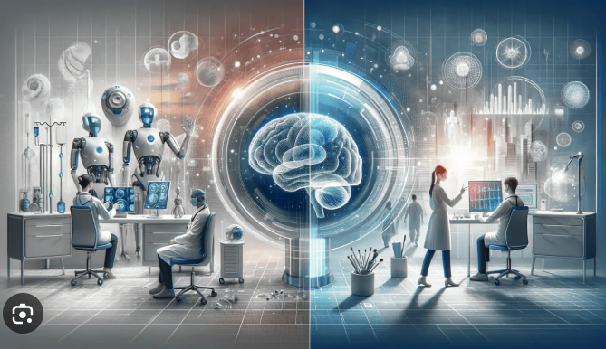
Problem Statement
People struggle to understand prescriptions
Limited access to quick health advice
No centralized AI wellness platform
Lack of personalized health tracking

Slide 5


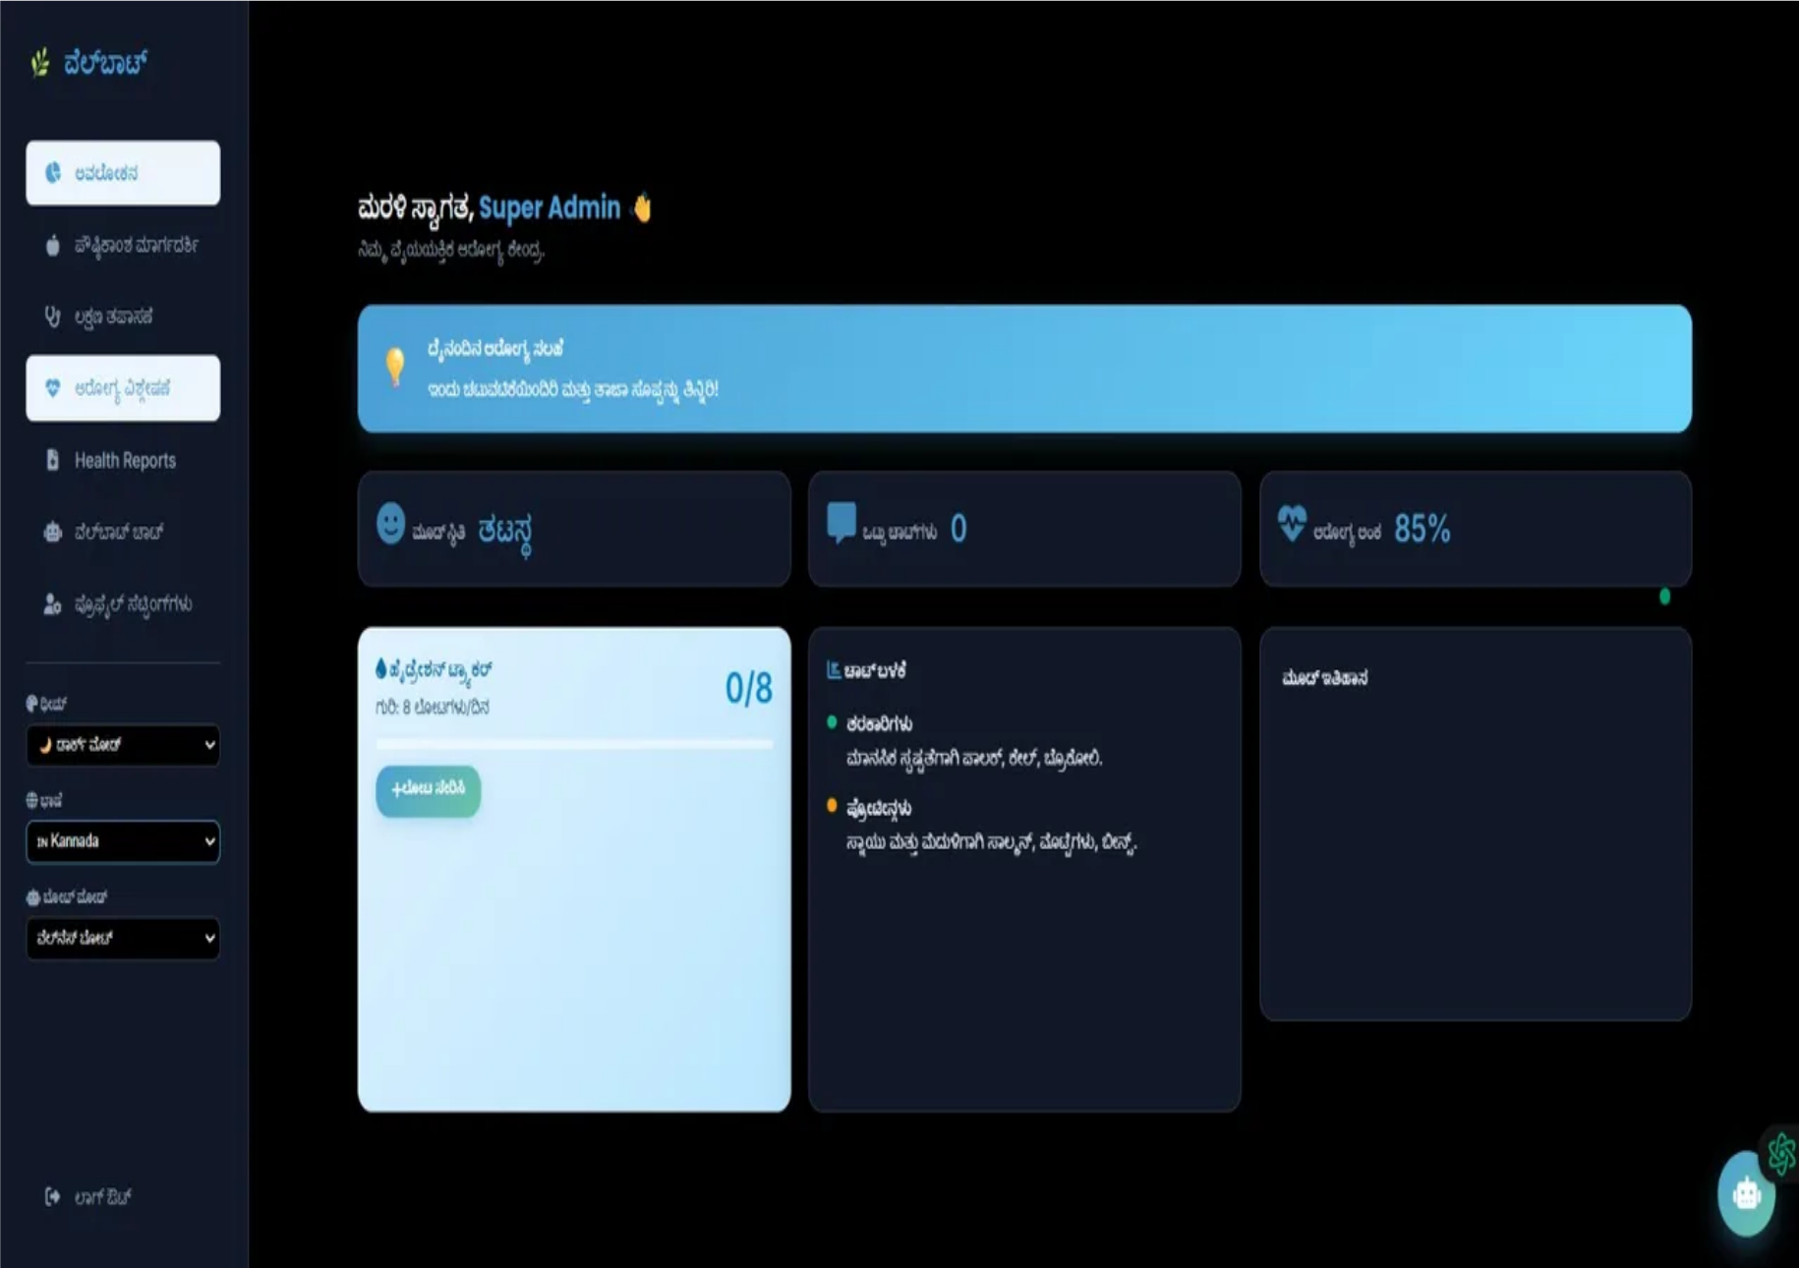

Multi-Language Support
WellBot bridges the communication gap by offering support in multiple languages.
English - Global accessibility
Hindi - National reach
Kannada - Regional localization
Spanish - International expansion
Enhancing communication for a healthier world.

Slide 6

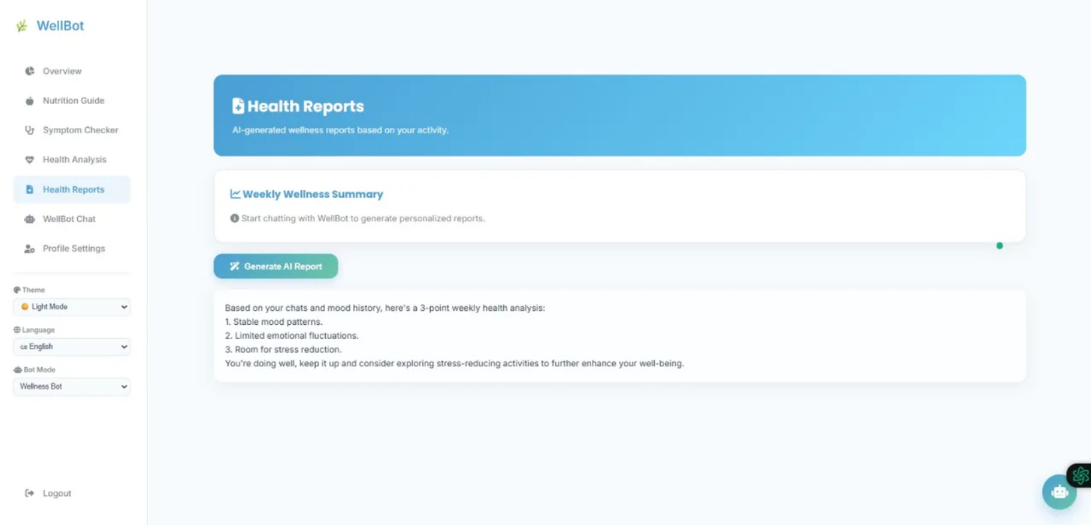

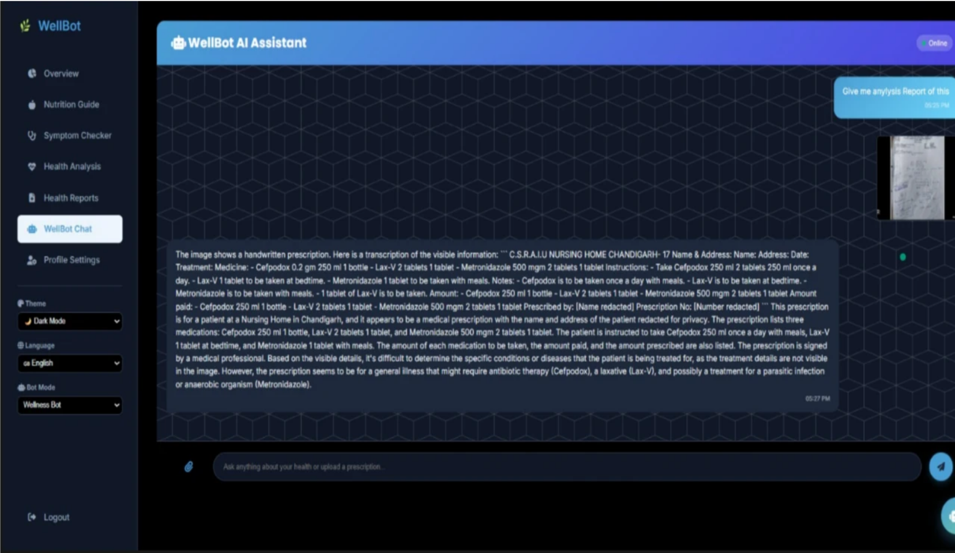
Dynamic Theme System
A customizable interface designed for user comfort and accessibility.
Light Theme - Professional and clean
Dark Theme - Reduces eye strain in low light
Automatic Adaptation - UI components adjust instantly
Readability - High contrast for all environments

Slide 7
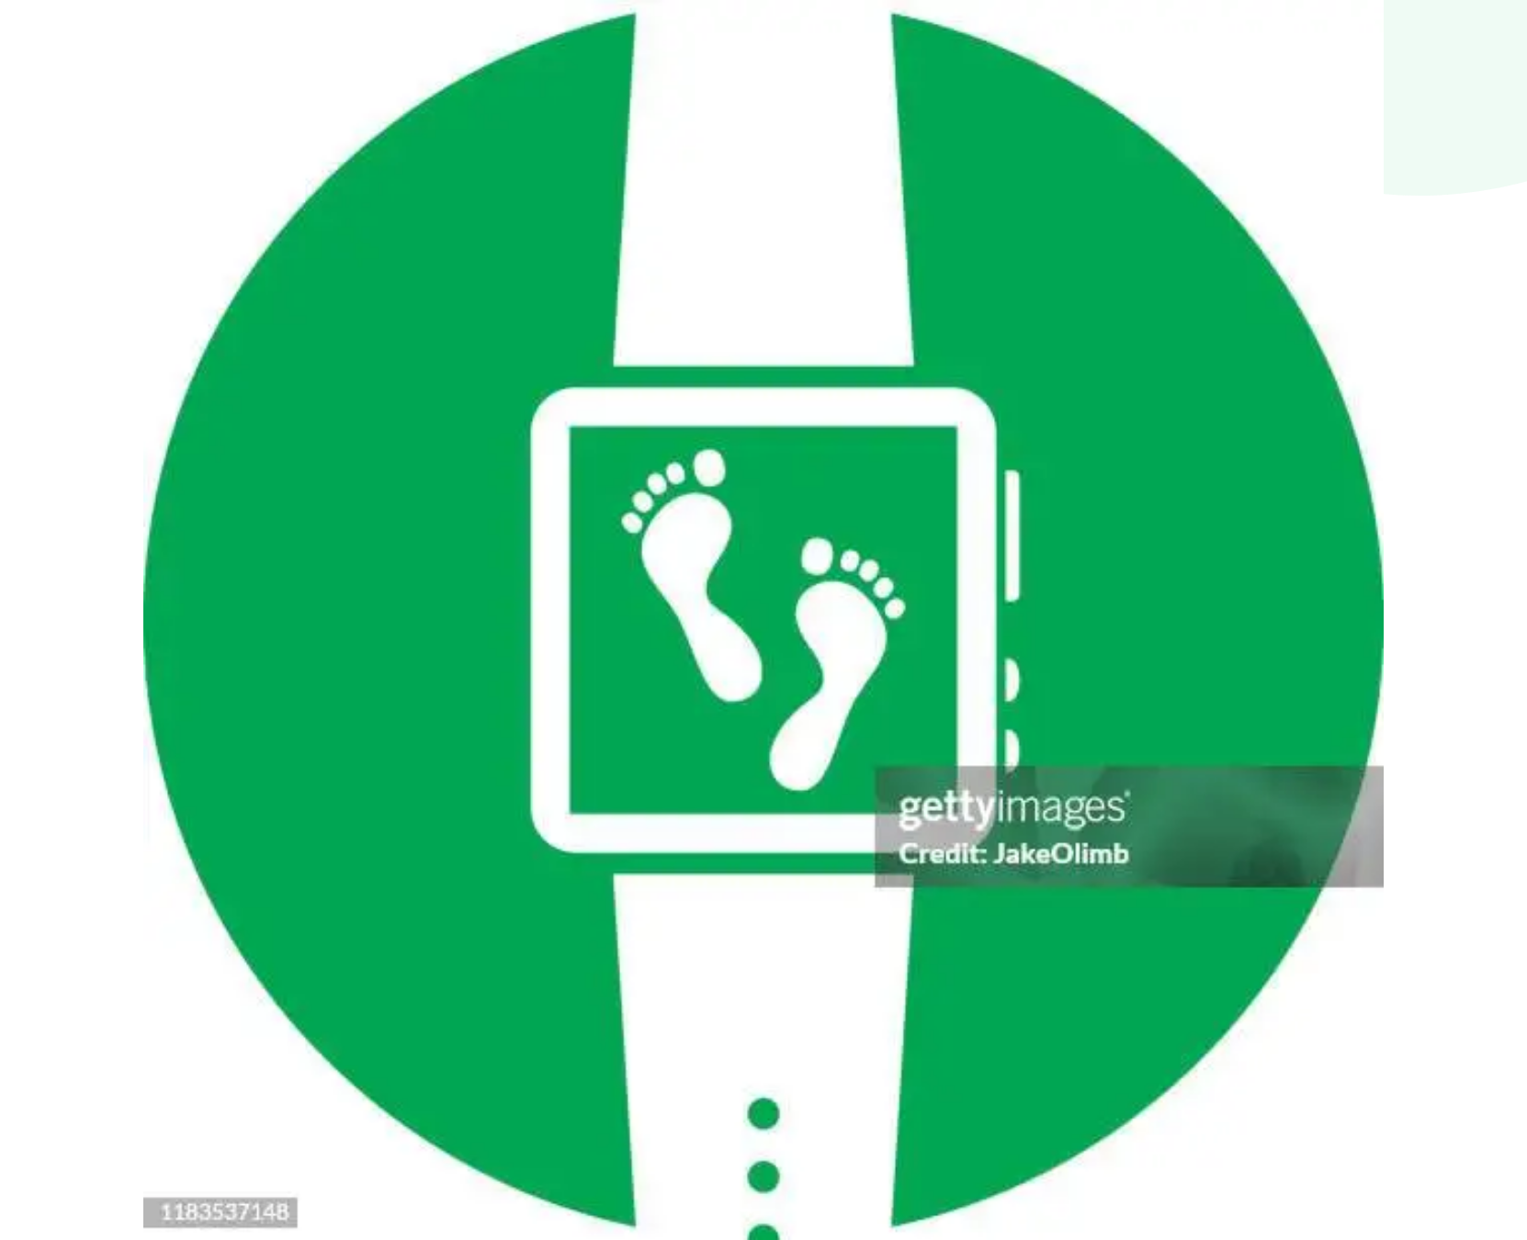
Real-Time Activity Tracking
👣
Footprint Counter
Tracks daily physical activity
Updates steps in real time
Displays progress on dashboard
Encourages healthy habits

Slide 8
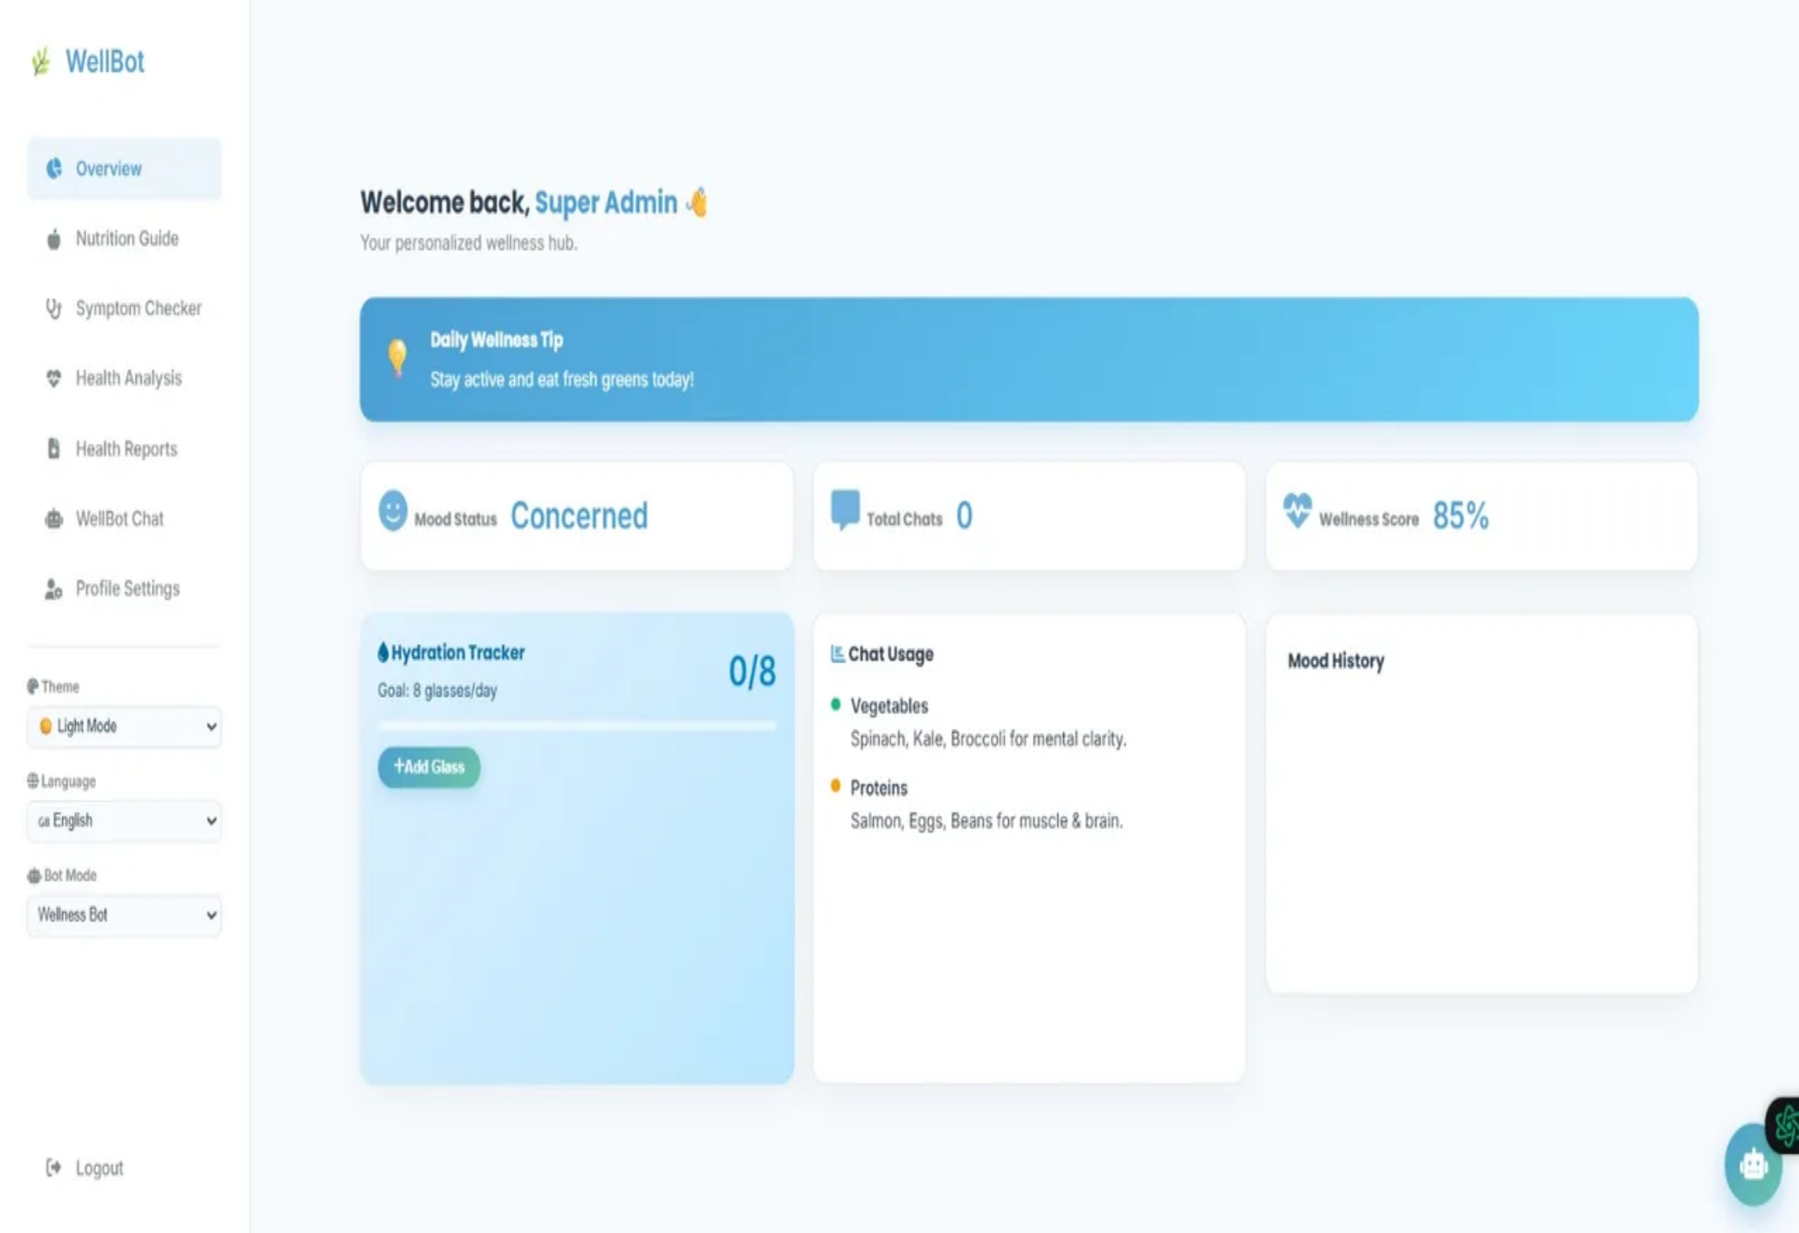
Admin Floating Chatbot Feature
Quick AI Interaction
Floating Icon - Accessible from any admin page
Instant Access - One-click chatbot testing
Efficiency - Monitor AI behavior in real-time
Seamless UI - Minimal impact on dashboard space

Slide 9
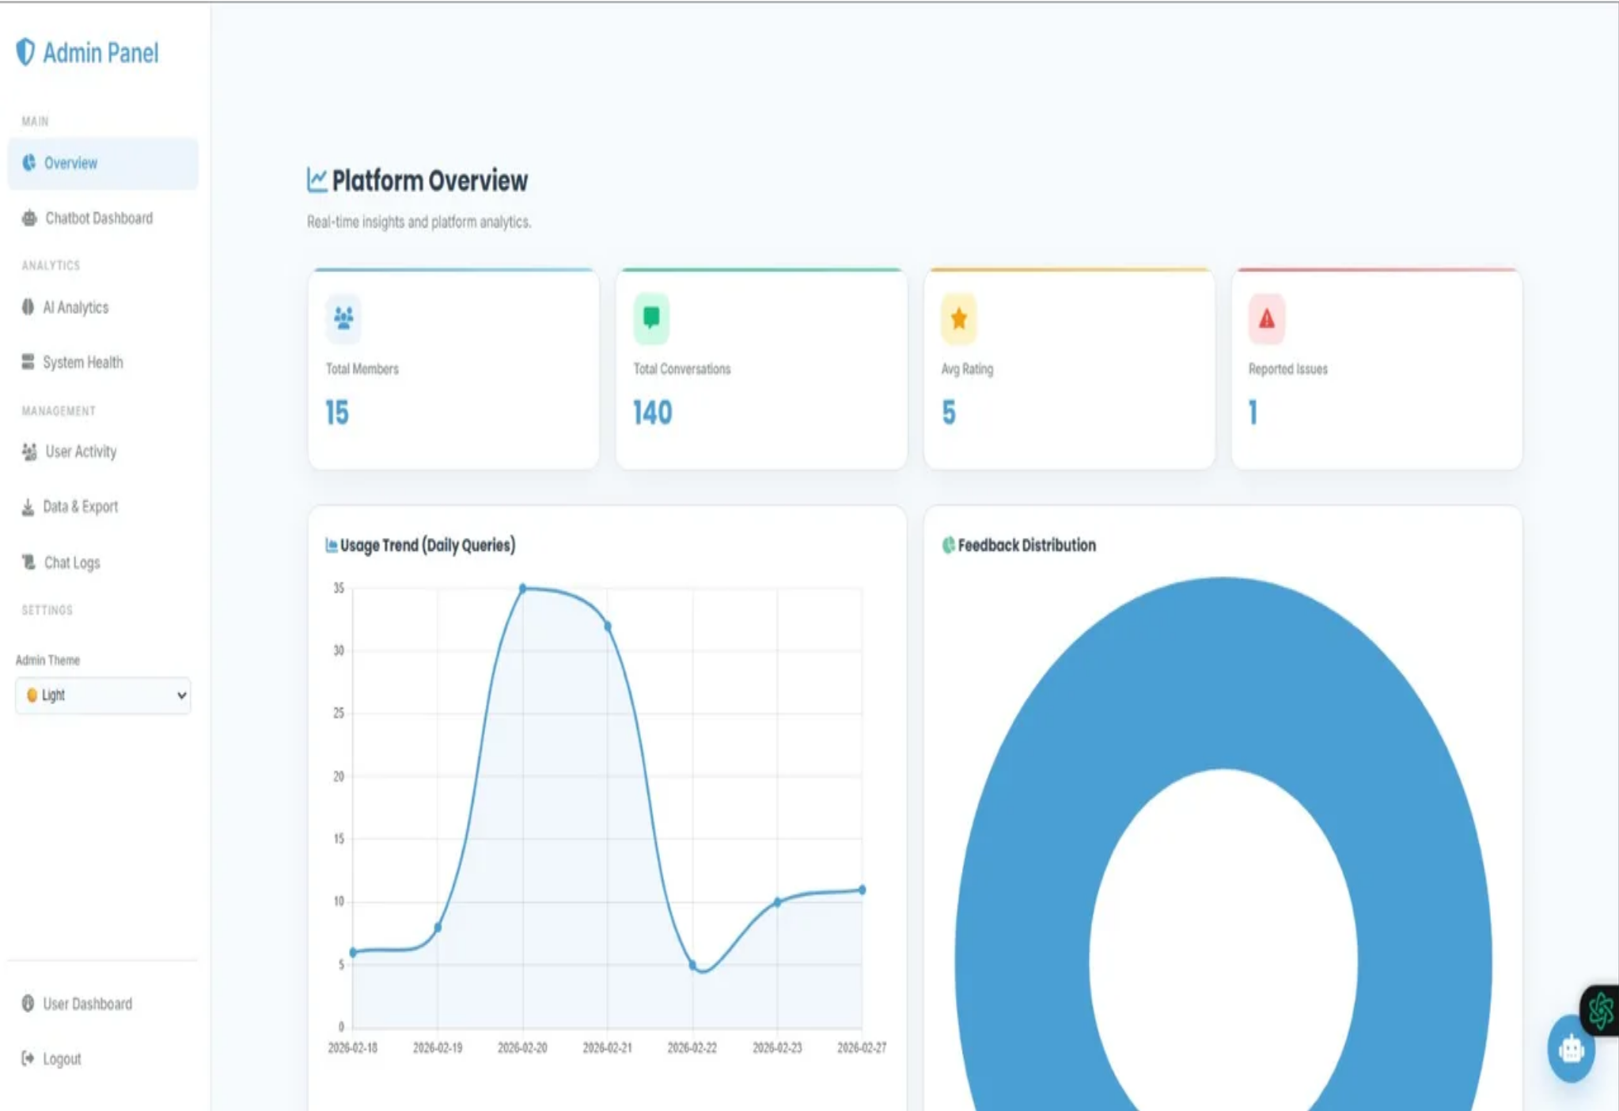







Admin Monitoring System
User Management - Track registrations and activity
Conversation Logs - Monitor AI interactions
System Analytics - Analyze usage statistics

Slide 10



Conclusion
WellBot is an intelligent wellness platform designed to provide accessible healthcare assistance using AI technology.
Faster, Smarter, and Accessible Healthcare for Everyone.

